Slide 1
Object oriented programming
(OOP)
Tamás Storcz

Slide 2
OOP motivation Business structure
IT domain
Task domain
manager
Employer
m
Customer
Dev
developer
specialist
Test
Prod
tester

Slide 3
OOP motivation
human:
Interesting – burnout
Less effort – Laziness – do not work too much…
business:
employer – quick work
employee – human
customer – accurate solution (errorless)
Efficiency

Slide 4
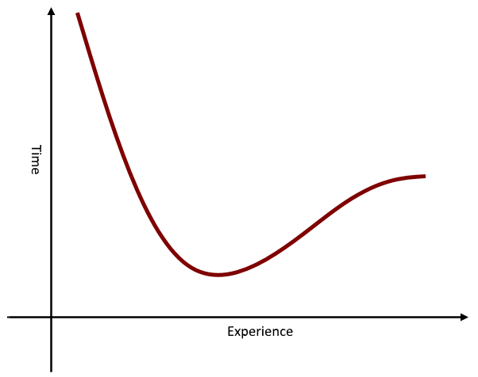
Interesting – flow
Burn-out
Repeated tasks
Same level of complexity
No joy
No measure of performance
No progress
Efficiency

Slide 5
Efficient programming - perspectives
What is efficient programming?
Using minimal number of instructions
Quickest execution
Lowest memory consumption
Maximum security
Continuous availability
Shortest development time
Sustainable source code
Compiler
API
Developer

Slide 6
Efficient programming
Aim: optimal resource utilization
What is the resource bottleneck?
From examination of projects with different size and complexity, considering solution quality and, project sustainability, the development bottleneck is the developer worktime.

Slide 7
Main tasks of developers
Creating new from scratch
Design and implementation
Modifying an existing solution – usually part of a framework
Find and fix errors – error reports
Modify existing operation – requirement changes
Extend functionality – new requirements
Understand requirements, find solution, implement, test, deliver

Slide 8
Efficient programming
To program efficiently, use as little developer resource, as possible for
understanding task domain knowledge
interpreting of previous implementations
writing boilerplates
updating documentations

Slide 9
Efficient programming – coding
Rate of reading : writing code when programming
10:1
Structure and names → Readable code
Common languge and thinking schema → GOOD names
Safe reuse of components

Slide 10
Readable code – Monolithic
do { n = s.nextInt(); } while (n <= 0 || n > max); int f = 1; for (int i = 1; i <= n; i++) { f *= i; } System.out.println(n + "!=" + f);

Slide 11
Readable code – Modular + names
int n = getPositiveIntFromConsole(
message: "Please enter positive number",
max: 10
); System.out.println(
n + "!="
+ calculateFactorial(n)
);

Slide 12
Modelling
Aim: to define a closed system, simplier than reality, in which the task can be solved well enough (time, accuracy, resources).
Model: A simplified interpretation of reality.
Model design:
Specify interesting properties, behaviors
Classification and class relations
Algorithms and data structures

Slide 13
Objects and Classification
Objects are classified based on type and meaning of their properties and behaviors – If objects have same properties and behaviors, they belong to the same class.
Objects are instances of classes.
Objects are distinguished by their place of existence (unique id). Values of their important properties could be the same.

Slide 14
Abstraction
The main tool of object creation and classification.
Abstraction of properties: Prescinding from property values, classification can be done. (Based on properties and behaviors.)
Abstraction level: On higher abstraction levels prescinding from less important properties and behaviors, class hierarchy creation is available.

Slide 15
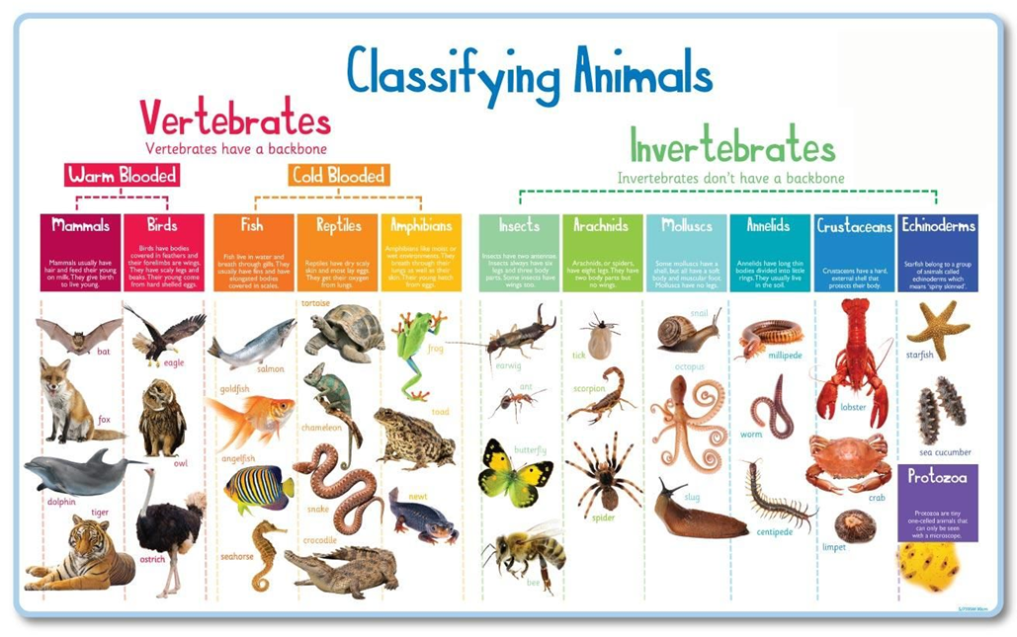
Abstraction – example

Slide 16
Object oriented programming
Object oriented programming is a programming methodology.
Most commonly used paradigm of nowadays.
It is focusing on design and implementation of connected program components – objects, hierarchically classified by their properties and behaviours.

Slide 17
Object oriented programming – for who?
Processor instruction set is very well defined
Low level programming:
Work with processor instruction sets
High level programming: avoid boilerplates, use APIs
Also translated to processor instructions to execute
Programming paradigms are created for programmers only – not for the machines
OOP executable is NOT better!!!

Slide 18
Message in OOP
When an object receives a message, it executes a behavior
Message can have details, which the behavior receives and processes
This is indeed the fancy name for method calls… (and a bit more)

Slide 19
OOP principals – meaning
Encapsulation
Encapsulate logically related data and their operation into a closed unit.
Inheritance
Derived classes inherit all properties and behaviors of parents, and they can define new ones.
Polymorphism
Inherited behaviors of derived classes can be modified, therefore they can response differently to the same message.

Slide 20
OOP principals - benefits
Encapsulation
Single responsibility, consistency, abstraction, safe reuse
Inheritance
Functions of a reused item can be extended
Polymorphism
Specialization of operation (specialized tasks of narrowing abstraction)
Exceptions of reuse – behave differently

Slide 21
OOP principles
S – single responsibility – There should never be more than one reason for a class to change.
O – open/close – Entities should be open for extension, but closed for modification.
L – Liskov substitution – Functions that use pointers or references to base classes must be able to use objects of derived classes without knowing it.
I – Interface segregation – Clients should not be forced to depend upon interfaces that they do not use.
D – Dependency inversion – Depend upon abstractions, [not] concretions.

Slide 22
Interface
Structural definition of a one direction connection surface. Declares the usage modes of the program component – object – which implements the interface.
Abstract descriptor of a one direction communication channel.
A contract about expected behaviors of a class, which implements the given interface.
Caller Class
Class
Property A
Interface
Property 1
Property B
Property 2
Behaviour A
Behaviour 1
Behaviour B
Behaviour 2

Slide 23
Encapsulation
Logically connected data and operations working on them are handled as one closed unit. Only a surface is provided to utilize its services by semi-explicit interface definition.
Benefits
Consistency – No contradiction in internal state descriptors – controlled state transitions
Abstraction – Usage thru an interface is independent from implementation
Secure reuse – Objects of same class are expected to work the same way
Single responsibility – On a given abstraction level, the object is responsible for only one thing

Slide 24
Data encapsulation
Classic C structures (struct)
Logically related data encapsulated in a distinct unit.
Operation
Declaration – based on a struct type
Initialization – data members one-by-one
Uncontrolled state changes could result inconsistent internal state

Slide 25
C struct
struct Document {
char* title;
char* description;
char* content;
} Document;
void appendLine(
Document doc, char* newLine
) {…}
Example from a medical experiment
struct Person{
int age;
int bmi;
bool male;
int numberOfPragnancy;
bool diabetes;
} Person;
Uncontrolled state change

Slide 26
Data & behavior encapsulation
Class
A template of objects with same descriptors and behaviors. Internal state of objects of the same class could differ, but descriptors match.
The template contains:
Internal state descriptors (logically related data)
Predefined initial state
Behaviors (projectors or state transitions)

Slide 27
Class declaration
class Person{
…
bool male;
int numberOfPragnancy;
…
void setPragnancy(int count)
{
if(male && count > 0)ERROR!
}
}
class Document {
public String title;
pubilc String description;
public String content;
public void appendLine(
String newLine
) {…}
}
Controlled state change

Slide 28
Consistent internal state
Why internal?
The state is object specific, exactly not known by the environment, because state descriptors are not accessible
Why consistent?
State descriptors always depict a valid state
How to provide consistency?
Predefined initial state
Controlled state transitions – controlled state descriptor modifications

Slide 29
Initialization – Special methods
Handlers of lifecycle events:
Creation – Constructor – A method for object initialization
Termination – Destructor – there is no destructor in Java

Slide 30
Constructor
class Document {
public String title;
pubilc String description;
public String content;
//constructor
}
public Document() {
title = ””;
description = ””;
content = ””;
}
Same name as the class
No return type

Slide 31
Default constructor
JVM requires constructor for object creation
Programmer can define constructor explicitly
A default constructor is added implicitly
class Document {
public Document() {}
}

Slide 32
Encapsulation – Consistency
Data hiding: Which state descriptors should be hidden from environment?
Hide all to keep the access really abstract. (independent from implementation)
Use the resource via this abstract interface in a controlled way.

Slide 33
Data hiding
How to hide data?
Use private modifier to define a component available only inside the object
Use public modifier to define a component available both inside and outside the object

Slide 34
Data access
Internal state descriptors are hidden – called: data members
Properties available via methods – no direct data property
Public getter methods
public <property type> get<property name>()
Public setter methods
public void set<property name>(<property type> newValue)

Slide 35
Getters and setters
class Document {
private String title;
public String getTitle() {
return title;
}
public void setTitle(String newTitle) {
title = newTitle;
}
}

Slide 36
Implicit class interface
Access from outside the class:
class Document {
String getTitle();
void setTitle(String newTitle);
}

Slide 37
Abstract interface
Independent from implementation
class Point {
private double X;
private double Y;
public double getX();
public double getY();
public double getRadius();
public double getAngle();
}
Depends on implementation
class Point {
public double X;
public double Y;
public double getRadius();
public double getAngle();
}

Slide 38
Reuse I – Classes and objects
Classes are templates for objects of same type (same properties and behaviors).
This is the first level of code reuse.
Objects are instances of classes
All objects of the same type have:
Custom values of common properties – instance data, instance state
Shared methods, working on instance data
Controlled state transitions – consistent internal state descriptors

Slide 39
Instantiation
Type of reference variable
Operator to
create instance
Constructor call to init
class Document {
private String title;
private String description;
private String content;
public Document() {…}
}
Document doc = new Document();
Name of reference variable
Instance type
Object reference is assigned to variable

Slide 40
Single responsibility
On a certain level of abstraction, the object is responsible for only a single thing – When the class has to be changed?
One of the most challenging parts of OOP! Could change through development.
Store users: User, User collection, Serialization, Storage management

Slide 41
Coherence
Class
prop_1, prop_2, prop_3
method_1 – prop_1, prop_2
method_2 – prop_2
method_3 – prop_3
Class_1
prop_1, prop_2
Method_1 – prop_1, prop_2
Method_2 – prop_2
Class_2
prop_3
Method_3 – prop_3

Slide 42
struct vs. class
struct
Class
Value type
Limited functionality
On assignment, value is duplicated
Requires space only for data
When storing lots of data, space-saving
Java has no struct
Reference type
Full functionality
On assignment, value is NOT duplicated
Requires space for reference also
Reorder is quicker
Java has class

Slide 43
OOP – Summary
Target
Only developers by source code organization
Tools
Define secure template – Encapsulation
Extend functionality – Inheritance
Specialize functionality – Polymorphism
Aim
Preparation of readable, maintainable, testable code
which is reliable and safely reusable

